Slide 1

CS 375: Information Security
Lecture 3
Block Ciphers & the Data Encryption Standard
Dr. Anwar Ghani
Department of Computer Science &SE
Internal Islamic University, Islamabad
Email: anwar.ghani@iiu.edu.pk

Slide 2
Stream Cipher Vs Block Cipher
Stream Cipher: Encrypts only one bit or byte at a time
Example: Vigenere Cipher
Block Cipher: an n bits block of plaintext is encrypted as a whole to produce n bit ciphertext
Examples: DES, AES

Slide 3

Ideal Block Cipher

Slide 4
Simplified DES (S-DES)
Developed by Professor Edward
Educational algorithm rather than a secure algorithm
Encryption process of S-DES takes an 8 bit block of plaintext and 10 bit key to generate an 8 bit ciphertext

Slide 5
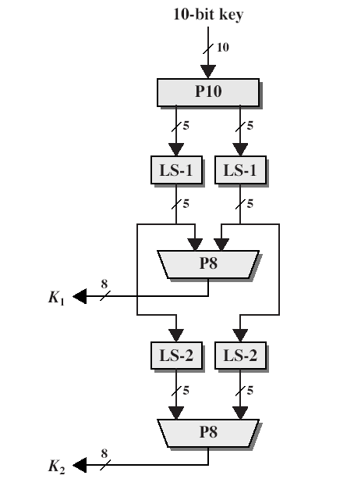


S-DES Key Generation
1001001110 (10 bit key)
Apply P-10
0001101110 (after P-10)
00011 01110 (2, five bits sets)
Apply LS-1 on both sets
00110 11100 (after LS-1)
Apply P-8
11111000 (after P-8)
This is first key (K1)

Slide 6
S-DES Key Generation
00110 11100 (after LS-1)
Apply LS-2
11000 10011 (After LS-2)
Apply P-8
10000011(after P-8)
This is second key (K2)

Slide 7
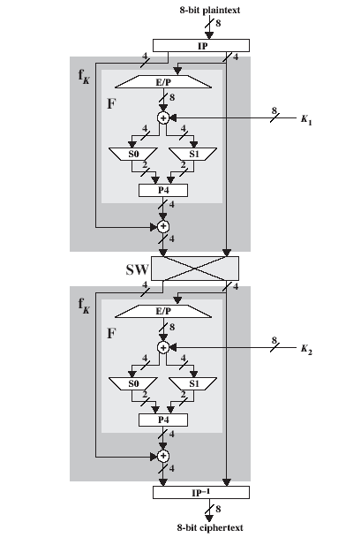
S-DES Encryption
Apply Initial Permutation (IP)
Use of complex function fK, which involves both permutation and substitution operations and depends on a key (K1) input
A simple permutation function (SW) that switches the two halves of data
Apply of fK with K2
Inverse of the Initial Permutation (IP⁻¹)

Slide 8


S-DES Encryption
10100001 (8 bit plaintext)
Apply IP
00110100 (After IP)
0011 0100 (2 four-bit sets)
Apply E/P over RHS (0100)
00101000 (After E/P)
11111000 (K1 as calculated)
11010000 (After XOR)
1101 0000 (2 four bit sets)

Slide 9


S-DES Encryption
1101(S0) 0000 (S1)
Apply S-boxes
11 (row 3), 01 (column 1)
1= 01 (S0)
00 (row 0), 00 (column 0)
0= 00 (S1)
0100 (after S boxes)
Apply P4
1000 (after P4)
0011 (LHS)
1011 (after XOR)

Slide 10

S-DES Encryption
1011 (After XOR)
0100 (RHS)
Apply SW
1011 (RHS after SW)
0100 (LHS after SW)
Now apply all these steps over 1011 (RHS)
Use K2 instead of K1
At the end apply IP⁻¹
01111110 (8 bit Cipher Text)

Slide 11
S-DES Decryption
Use ciphertext as input (ciphertext)
Reverse the keys order(K2 instead of K1 and vice versa)
At the end 8-bit plain text will be recovered
10100001 (plain text)

Slide 12
Diffusion & Confusion Concepts
Diffusion – dissipates statistical structure of plaintext over bulk of ciphertext (more than one cipher against one plain text)
An example of diffusion is to encrypt a message M = m1, m2, m3,... of characters with an averaging operation: (eq. on page 67)
Adding k successive letters to get a ciphertext letter yn
Thus the statistical structure of the plaintext has been dissipated
Confusion – makes relationship between ciphertext and key as complex as possible

Slide 13
Feistel Cipher Structure
Horst Feistel devised the feistel cipher
  based on concept of invertible product cipher
Partitions input block into two halves
  process through multiple rounds
  perform a substitution on left data half
  based on round function of right half & subkey
  then have permutation swapping halves
Implements Shannon’s S-P net concept

Slide 14
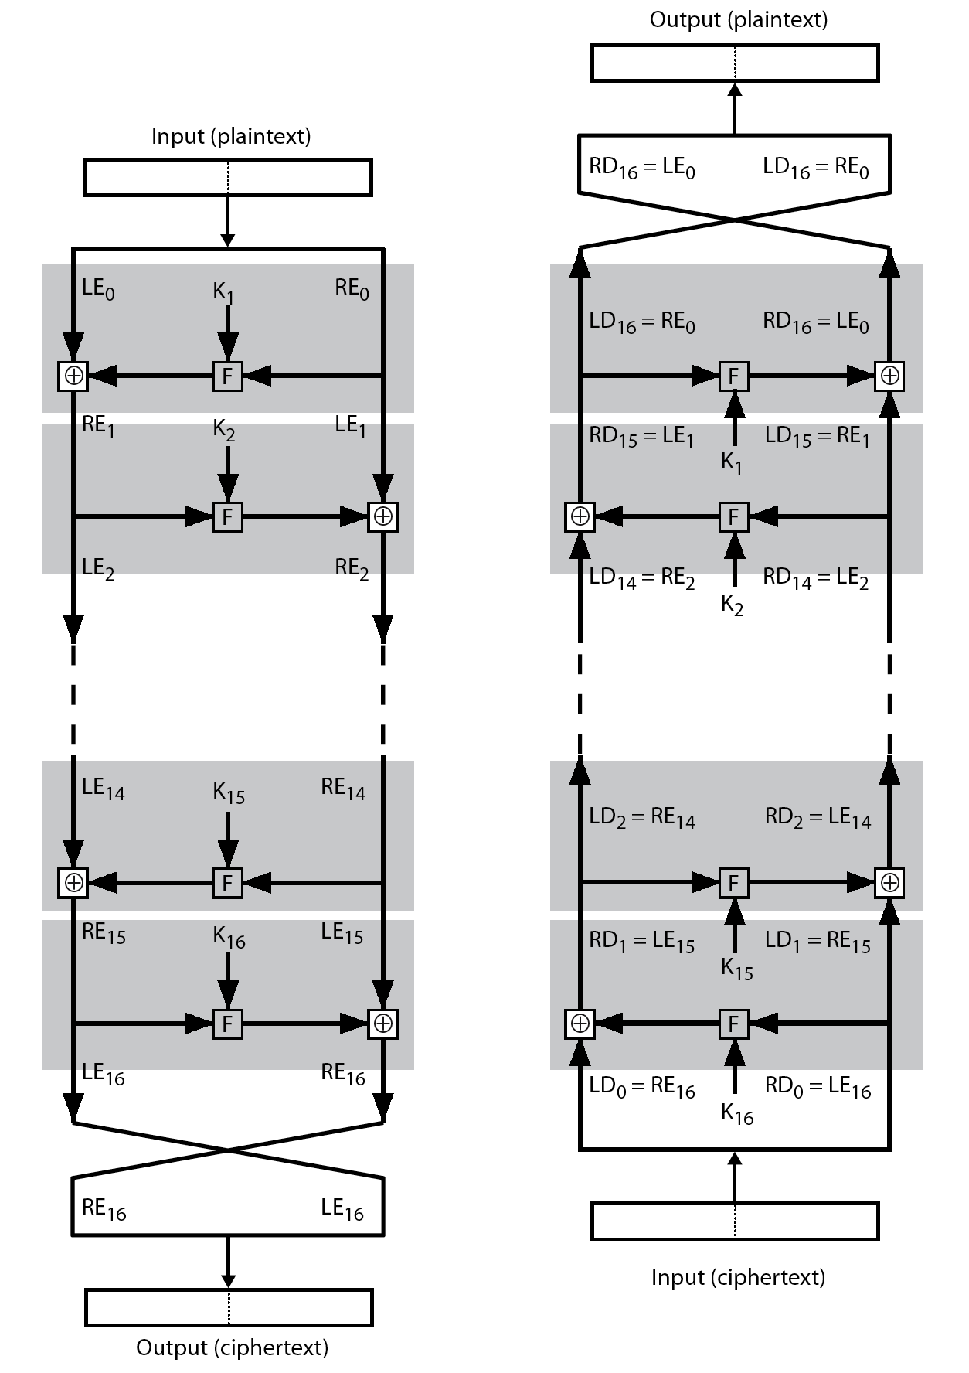
Feistel Cipher Encryption/Decryption
Design Elements
Block size
Key size
Number of rounds
Subkey generation algorithm
Round function
Fast software en/decryption
Ease of analysis

Slide 15
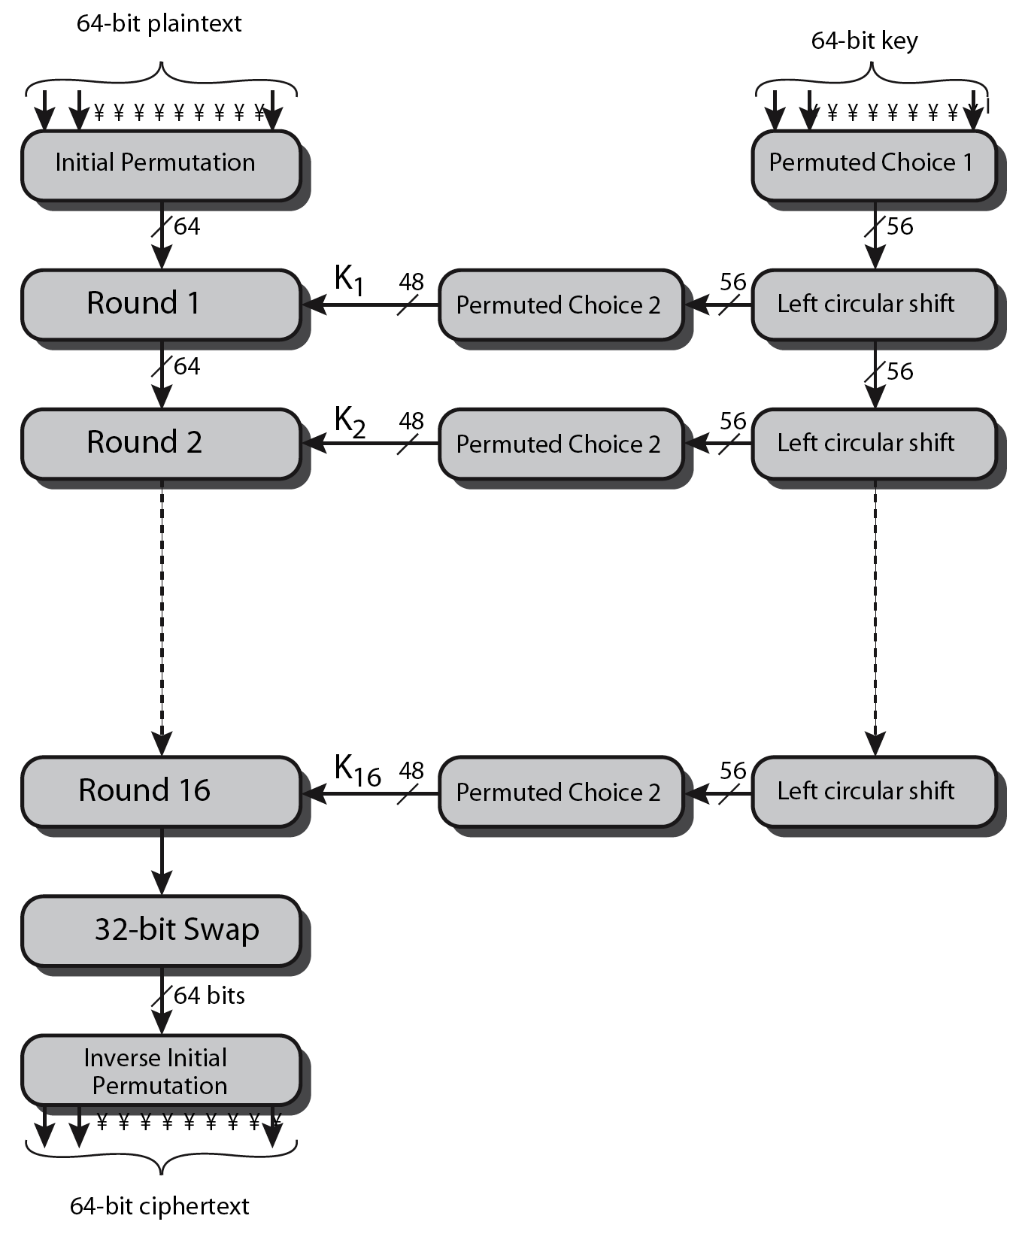
Data Encryption Standard (DES)
Most widely used block cipher in world
Encrypts 64-bit data using 56-bit key
Widespread use

Slide 16
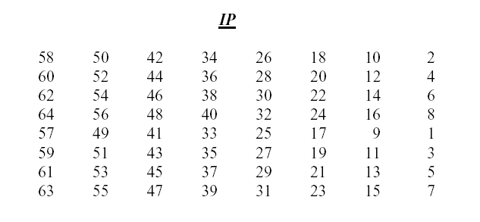
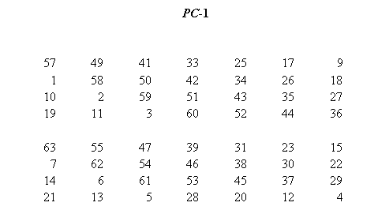
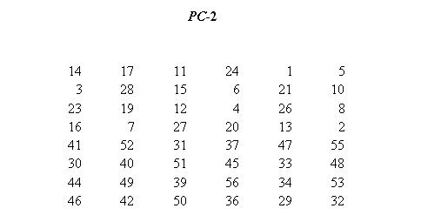
Initial Permutation, PC-1 & PC-2

Slide 17
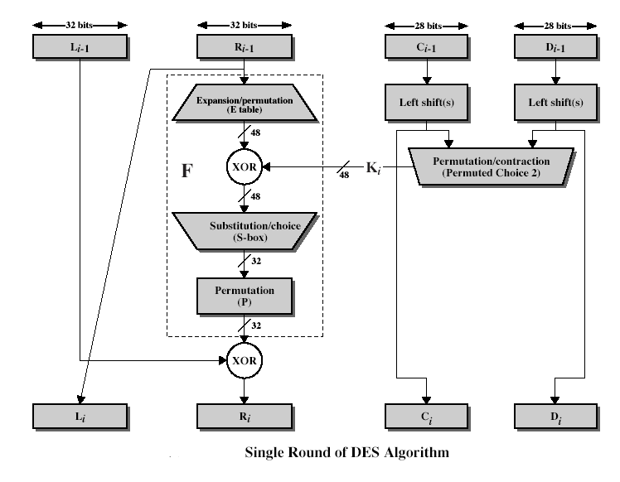
Single Round of DES

Slide 18
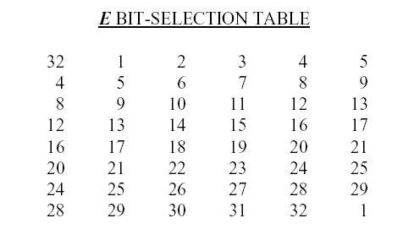
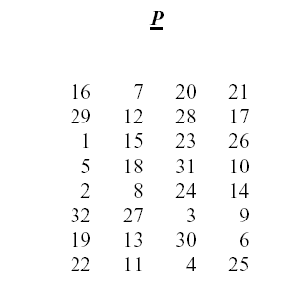
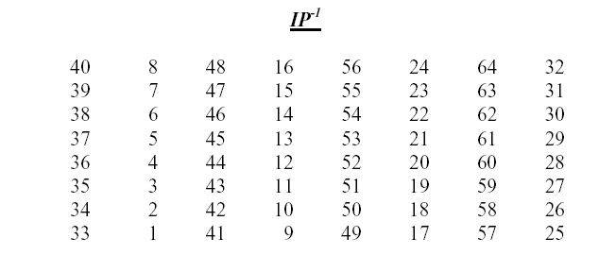
Expansion/Permutation & IP⁻¹

Slide 19
Avalanche Effect
key desirable property of encryption algorithm
where a change of one input or key bit results in changing approx half output bits
making attempts to “home-in” by guessing keys impossible
DES exhibits strong avalanche

Slide 20
Strength of DES – Key Size
56-bit keys have 2⁵⁶ = 7.2 x 10¹⁶ values
brute force search looks hard
recent advances have shown is possible
  in 1997 on Internet in a few months
  in 1998 on dedicated h/w (EFF) in a few days
  in 1999 above combined in 22hrs!
still must be able to recognize plaintext
must now consider alternatives to DES

Slide 21
Cryptanalysis
Differential
Linear

Slide 22
Block Cipher Modes of Operation
Electronic Codebook
Cipher Block Chaining
Cipher Feedback
Output Feedback
Counter

Slide 23
Assignment 2
S. No | Plain Text | Key
1 | 10011001 | 1110011100
2 | 10011001 | 1100011000
3 | 10011001 | 1100110011
4 | 10011001 | 1111100000
5 | 10011001 | 1010101010

Slide 24
Assignment 2
6 | 10101010 | 1101101101
7 | 01010101 | 1101101101
8 | 11001100 | 1101101101
9 | 00110011 | 1101101101
10 | 11110000 | 1101101101
11 | 00001111 | 1101101101
12 | 11000011 | 1101101101

